Slide 1

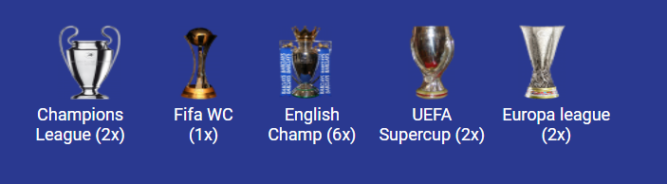
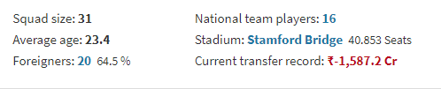
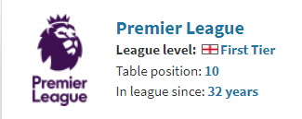
DATATHON 24
Problem Statement: The football data dilemma
Team : GFC [Glitch Free Coders]
Members:
Vedant Pawar | Nikhil Singh | Soham Tawade [VESIT]
Chelsea FC

Slide 2
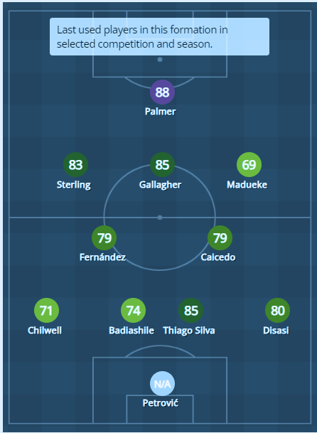
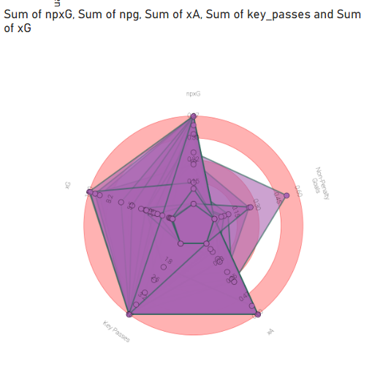
Chelsea FC
Team Formation:
[frequently used]
npxG, npg, xA, Key_passes, xG
NAME | POSITION
Đ. Petrović | GK
A. Disasi | DR
Thiago Silva | DCR
B. Badiashile | DCL
B. Chilwell | DL
M. Caicedo | DMCR
E. Fernández | DMCL
N. Madueke | AMR
C. Gallagher | AMC
R. Sterling | AML
C. Palmer | S
Radar plot
Team formation

Slide 3
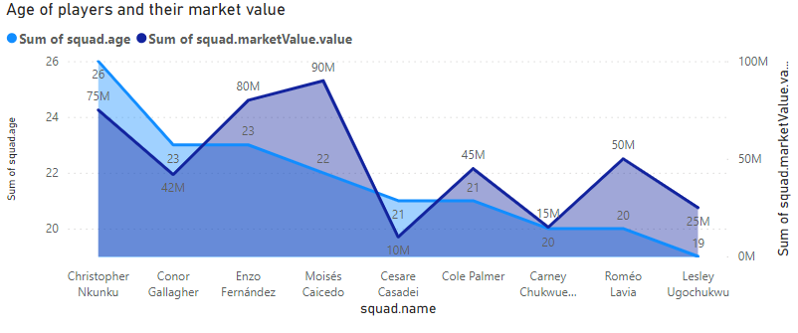
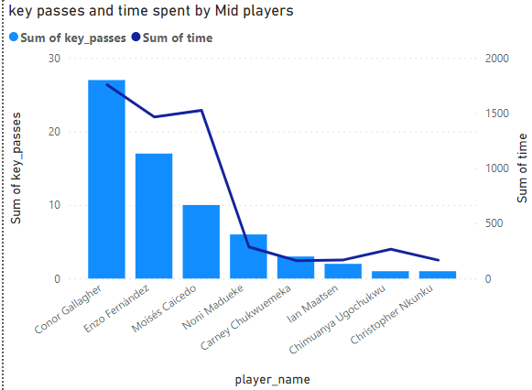
Chelsea FC
Players Available for Transfer Listing:
Midfielders:
Strategy based on age, market value, key passes, and time spent on the field.
Players Sold:
Name vs Age & market value
Name vs Keypasses & time on field

Slide 4
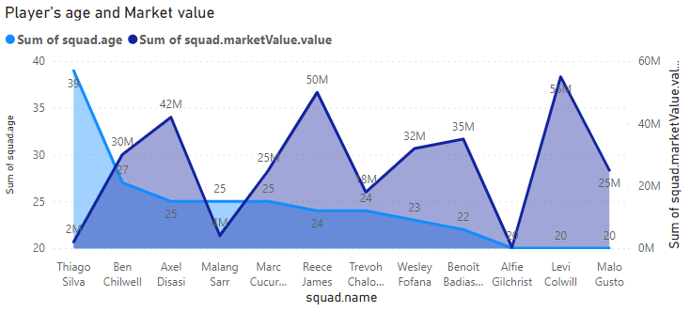
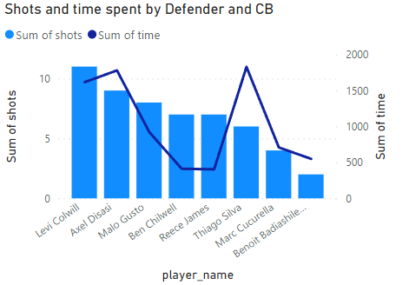
Chelsea FC
Players Available for Transfer Listing:
Defenders:
Strategy based on age, market value, shots to save goals, and time spent on the field.
Players Sold:
Name vs Age & market value
Name vs Shots and time on field

Slide 5
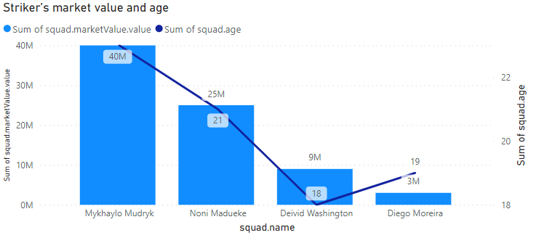
Chelsea FC
Players Available for Transfer Listing:
Strikers:
Strategy based on age, market value, and time spent on the field.
Players Sold:
Name vs Age & market value

Slide 6
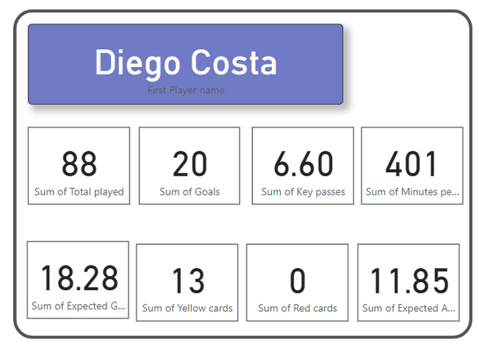
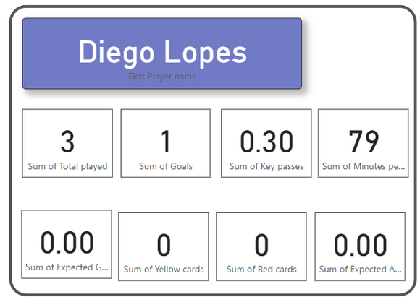
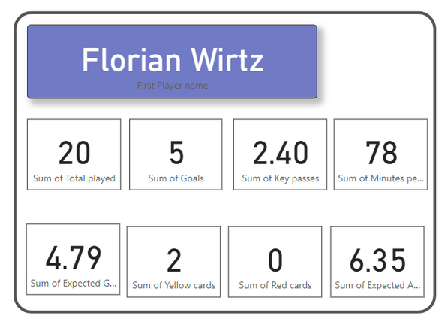
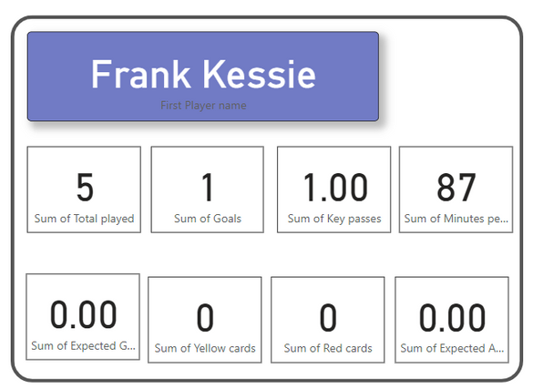
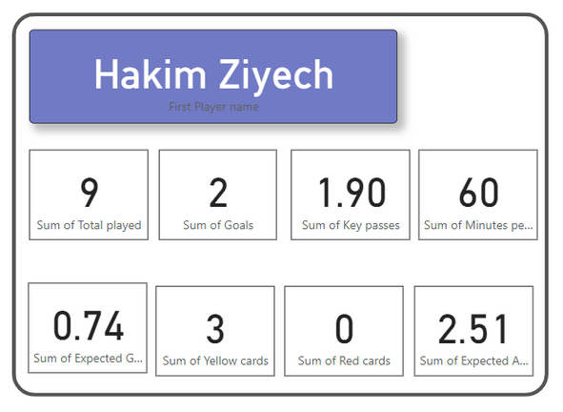
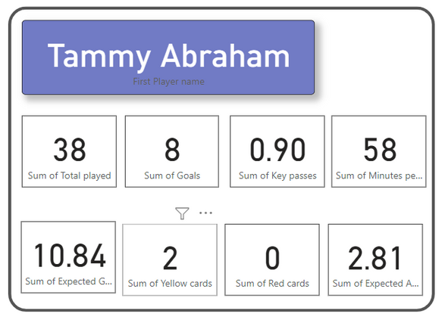
Chelsea FC
Targeted Players for Acquisition in the Transfer Market:
Free trade
£1.29
m. pounds
£86.0
m. pounds
£1.36
m. pounds: Market Fee
£ 17.2
m. pounds
Free
trade
£30.1
m. pounds
m. fee: £10.3 mil

Slide 7
Chelsea FC
Budget:
Strikers:
Strategy based on age, market value, and time spent on the field.
£150m+ £25m (Transfer fee of Nicholas J.)
Selling Players with Less ROI:
Players sold: Alfie G(CB),Lucas B(GK), Djeordjep(GK), Cesare C(CMF) = £16.89m
Capital before making purchases: £175m+ £16.89m = £ 191.89m.
Players Bought:
Tammy Abraham (S), Franck Kessie (CM), Hakim Ziyeh (RW),
Florian Wirtz (Star Mid Fielder bought for £85.23m,),
Diego Costa (CF), Diego Lopes (AMF).
Following the transactions in the transfer market,
our available funds amount to £72 million.

Slide 8
Chelsea FC
Conclusion:
Strategy based on age, market value, and time spent on the field.
Players Sold:
Alfie G. (CB) | Lucas Burk (GK)
Djordje P. (Gk) | Cesare C. (CMF)
Florian W.
Romeo L.
Players Bought:
Substitutes:
Tammy A (S)
Franck K (CM)
Florian W (CM)
Hakim Z (RW)
Diego C (CF)
Diego L (AM)
Markus B. (GK)
Levi C. (CB)
Christopher M. (AMF)
Tammy A. (S)
Hakim Z (S)
Robert S.

Slide 9
Chelsea FC
Bonus Suggestion:
Investing in Merchandise During Transfer Market Trades:
Increased Fan Engagement: High-profile transfers generate excitement and buzz, potentially driving fans to purchase merchandise featuring the new players.
Limited Edition Opportunities: Capitalize on the short-lived hype by offering limited-edition items.
Brand Building: Fueling our club's ambition, we seek to acquire top-performing players while maintaining a balanced financial approach for sustained success.

Slide 10
Chelsea FC
Bonus Suggestion [Case study] : Manchester United's Cristiano Ronaldo Transfer (2021)
Sales of Chelsea shirts have improved by 22% after winning the UEFA Champions League and FIFA Club World Cup in 2021, in comparison to the season before. The third-best-selling home kits in the premier league. Chelsea sold 1.85 million units of shirts this season so far and generated a total of £92.8m million in sales from their Retail, Merchandise, Apparel & Product Licensing Revenue.

Slide 11
Data sets used:
Transfer market API: Link
Understat functions: Link
Sofascore: Link

Slide 12
Thank you.

